Slide 1
SPACE AND TIME TRADE OFFS

Slide 2
Things which matter most must never be at the mercy of things which matter less.
~ Johann Wolfgang van Goethe

Slide 3
WHAT IS SPACE – TIME TRADE OFF?
The best algorithm to solve any problem is one which takes less amount of time to complete its execution and also requires less space in memory.
This is an ideal case and hence not always possible to achieve in practice.

Slide 4
WHAT IS SPACE – TIME TRADE OFF?
If time is at a premium, it is practical to choose an algorithm which takes less execution time but consumes a lot of space.
Conversely, if space is a constraint, it is advisable to choose an algorithm which takes a long time to execute but consumes very little space.

Slide 5
WHAT IS SPACE – TIME TRADE OFF?
Based on the situation, we may have to sacrifice one at the cost of another.
This is a case of SPACE – TIME TRADE OFF.

Slide 6
SORTING BY COUNTING

Slide 7
THE IDEA
Example of applying Input Enhancement.
For each element ‘X’ of a list to be sorted, count the total number of elements in the list less than ‘X’.
Record these results in a table.
These numbers will indicate the positions of the elements in the sorted list.

Slide 8
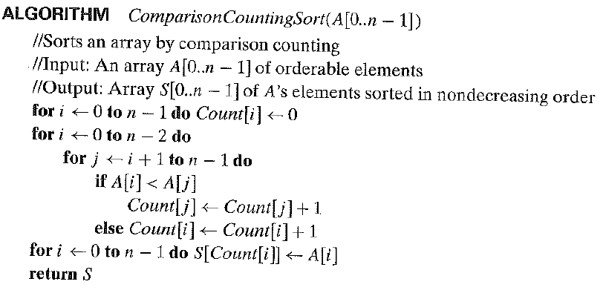
THE ALGORITHM

Slide 9
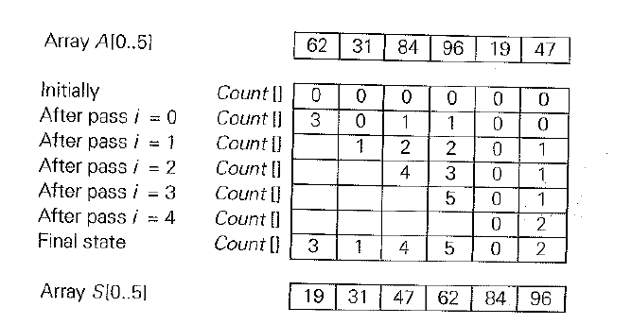
AN EXAMPLE

Slide 10
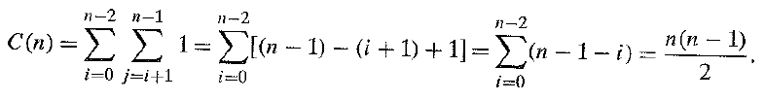
TIME EFFICIENCY
Basic Operation:
The comparison A[i] < A[j]

Slide 11
VARIATION - DISTRIBUTION COUNTING
If the list to be sorted has element values, which are integers between some lower bound I and upper bound u, we can compute the frequency of each of these elements and store them in an array F[0…u-l].
Then, the first F[0] positions in the sorted list will contain l, the next F[1] positions will contain l + 1 and so on.

Slide 12
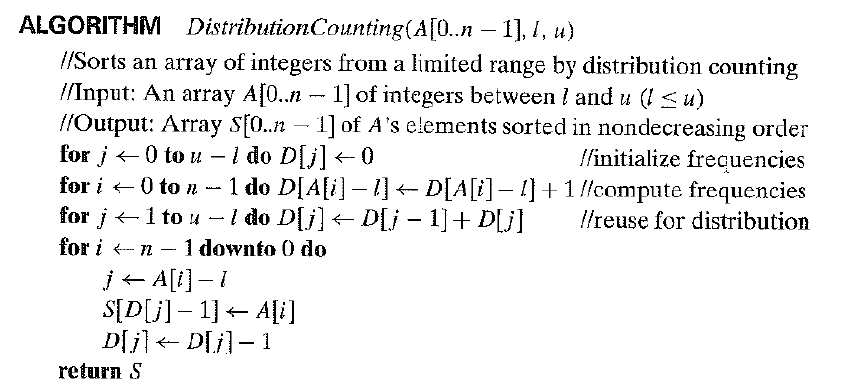
THE ALGORITHM

Slide 13

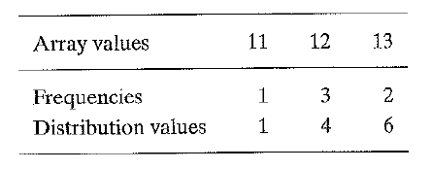
AN EXAMPLE

Slide 14
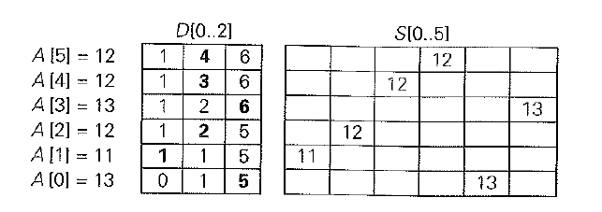
AN EXAMPLE

Slide 15
INPUT ENHANCEMENT IN STRING MATCHING

Slide 16
STRING MATCHING PROBLEM
Finding an occurrence of a given string of m characters called the pattern in a longer string of n characters called the text.

Slide 17
INPUT ENHANCEMENT IN STRING MATCHING PROBLEM
Pre - process the pattern to get information about it.
Store the information in a table.
Use this information during search.
Examples:
Horspool’s Algorithm
Boyer – Moore Algorithm
And more

Slide 18

HORSPOOL’S ALGORITHM
Consider an example of searching the pattern “BARBER” in some text.
Start with the last ‘R’ of the pattern, move right to left and compare corresponding characters.
If all characters match, then a pattern is found.

Slide 19
HORSPOOL’S ALGORITHM
If a mismatch is found, we should move the pattern to the right.
And, we would like to make as large a shift as possible.
Horspool’s algorithm determines the size of the shift by looking at the last character ‘c’ of the text which is matched against the last character of the pattern.
In general, the following four possibilities can occur.

Slide 20
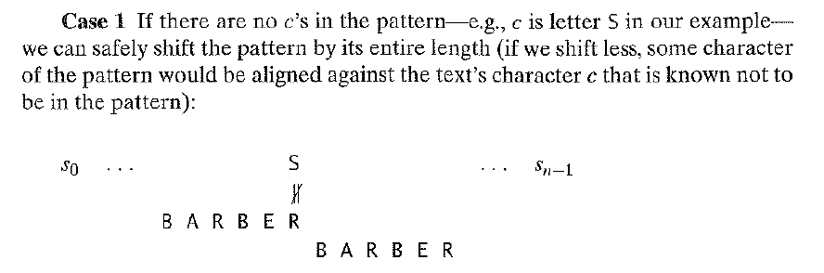
HORSPOOL’S ALGORITHM – CASE 1

Slide 21
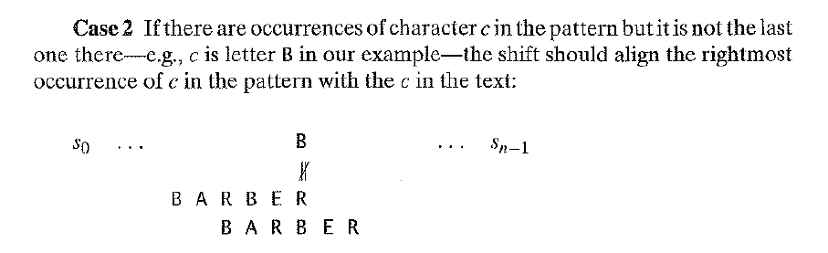
HORSPOOL’S ALGORITHM – CASE 2

Slide 22
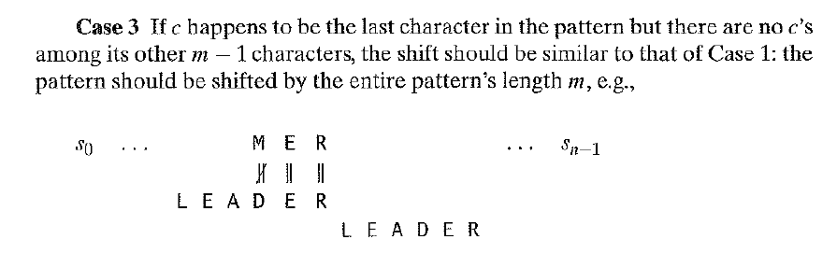
HORSPOOL’S ALGORITHM – CASE 3

Slide 23
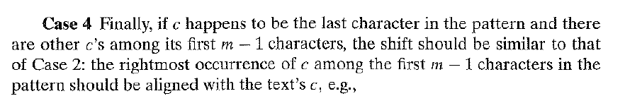
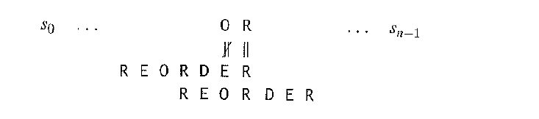
HORSPOOL’S ALGORITHM – CASE 4

Slide 24
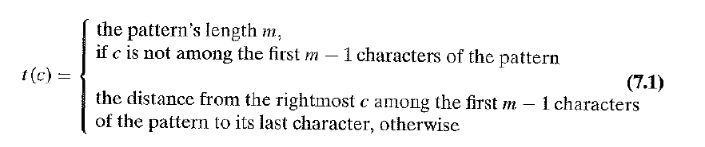
HORSPOOL’S ALGORITHM
The shift sizes are pre – computed and stored in a table.
The table will be indexed by all possible characters that can be encountered in a text.
The table’s entries will indicate shift sizes calculated by:

Slide 25
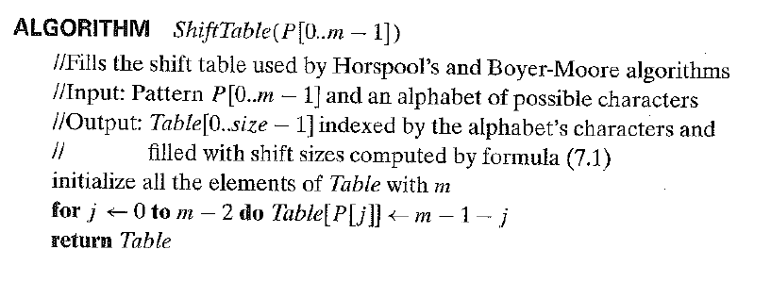
HORSPOOL’S ALGORITHM – SHIFT TABLE GENERATION

Slide 26
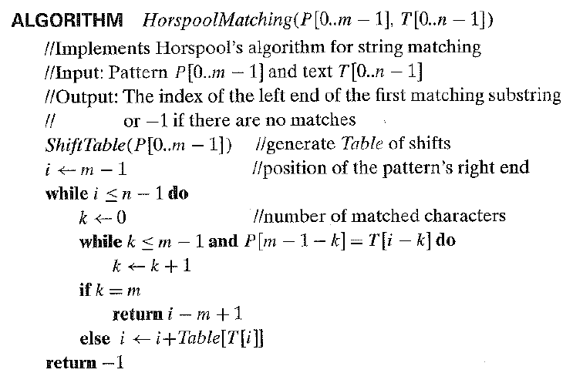
HORSPOOL’S ALGORITHM – MATCHING

Slide 27
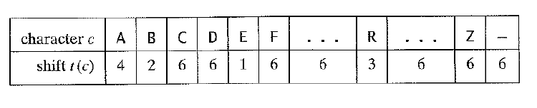
HORSPOOL’S ALGORITHM – EXAMPLE
Pattern = BARBER

Slide 28
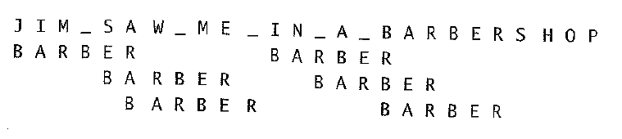
HORSPOOL’S ALGORITHM – EXAMPLE
Pattern = BARBER

Slide 29
HORSPOOL’S ALGORITHM - EFFICIENCY
Worst – Case Efficiency: Θ(nm)
For random texts: Θ(n)

Slide 30
BOYER – MOORE ALGORITHM
The Boyer – Moore algorithm is similar to the Horspool’s algorithm.
If the first comparison of the rightmost character in the pattern with the corresponding character c in the text fails, it shifts the pattern to the right by the number of characters retrieved from the precomputed table.

Slide 31
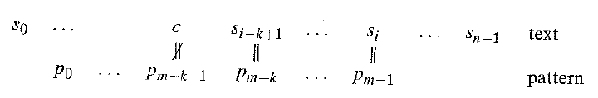
BOYER – MOORE ALGORITHM
The Boyer – Moore algorithm acts differently when compared to the Horspool’s algorithm if some positive number k (0 < k < m) of the pattern’s characters match the text before a mismatch is encountered.

Slide 32
BOYER – MOORE ALGORITHM
In such a situation, the shift size is calculated by considereing two quantities.
The text’s character c that caused the mismatch with its counterpart in the pattern. – BAD SYMBOL SHIFT.
If there is a successful match of the last k > 0 characters of the pattern. The ending portion of the pattern is referred to as its suffix. – GOOD SUFFIX SHIFT.

Slide 33
BAD SYMBOL SHIFT
If c is not in the pattern, we shift the pattern to just pass this character in the text.
The size of this shift is computed by the formula: t₁(c) – k
t₁(c) - Entry in the precomputed table
k – Number of matched characters

Slide 34
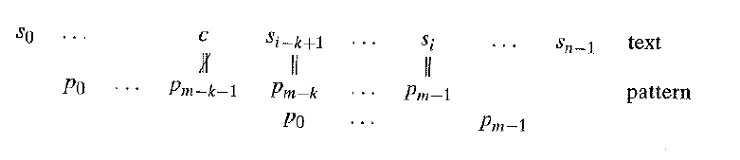
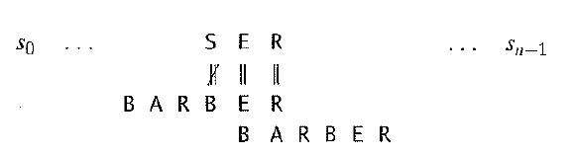
BAD SYMBOL SHIFT
t₁(S) = 6 – 2 = 4

Slide 35
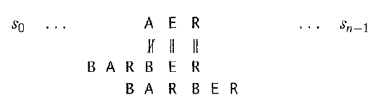
BAD SYMBOL SHIFT
The same formula can be applied when the mismatching character c of the text occurs in the pattern if t1(c) – k > 0.
t₁(A) – k = 4 – 2 = 2

Slide 36
BAD SYMBOL SHIFT - SUMMARY
The bad symbol shift d1 is computed by the Boyer Moore algorithm as follows:
d₁ = max {t₁(c) – k, 1}
[1 if t1(c) – k <= 0]

Slide 37
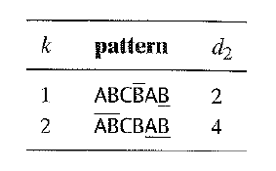
GOOD SUFFIX SHIFT
If there is another occurrence of suff(k) not preceded by the same character as its rightmost occurrence: the pattern is shifted by d₂ between such a second rightmost occurrence of suff(k) and its rightmost occurrence.

Slide 38
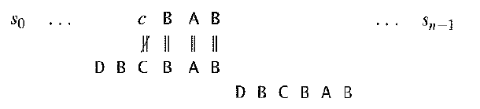
GOOD SUFFIX SHIFT
If there is no occurrence of suff(k) not preceded by the same character as its rightmost occurrence: the pattern is shifted by its entire length m.

Slide 39
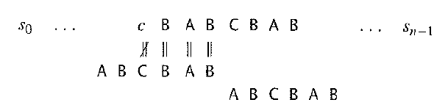
GOOD SUFFIX SHIFT
Shifting by the entire pattern length when there is no other occurrence of suff(k) not preceded by the same character will lead to incorrect solutions.

Slide 40
GOOD SUFFIX SHIFT
To avoid such an erroneous shift based on a suffix of size k, for which there is no other occurrence in the pattern not preceded by the same character as in its last occurrence, we need to find the longest prefix of size l < k that matches the suffix of the same size I.
If such a prefix exists, the shift size d₂ is computed as the distance between this prefix and the corresponding suffix; otherwise, d₂ is set to the pattern's length m.

Slide 41
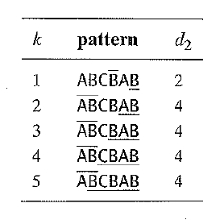
GOOD SUFFIX SHIFT

Slide 42
THE ALGORITHM
Step 1 For a given pattern and the alphabet used in both the pattern and the text, construct the bad-symbol shift table as described earlier.
Step 2 Using the pattern, construct the good-suffix shift table as described.
Step 3 Align the pattern against the beginning of the text.

Slide 43
THE ALGORITHM
Step 4
Repeat the following step until either a matching substring is found or the pattern reaches beyond the last character of the text.
Starting with the last character in the pattern, compare the corresponding characters in the pattern and the text until either all m character pairs are matched (then stop) or a mismatching pair is encountered after k 2: 0 character pairs are matched successfully.
In the latter case, retrieve the entry t₁(c) from the c's column of the bad-symbol table where cis the text's mismatched character.

Slide 44
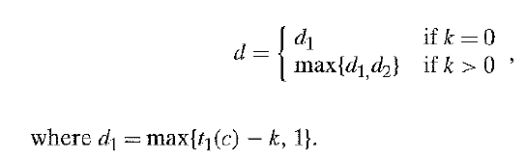
THE ALGORITHM
If k > 0, also retrieve the corresponding d₂ entry from the good-suffix table. Shift the pattern to the right by the number of positions computed by the formula:

Slide 45
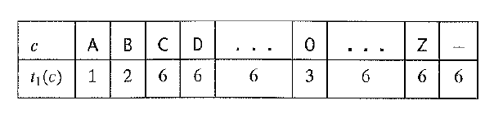
THE EXAMPLE
Pattern: BAOBAB
Bad Symbol Shift Table:

Slide 46
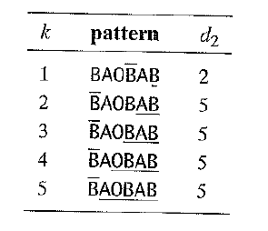
THE EXAMPLE
GOOD SUFFIX TABLE:

Slide 47
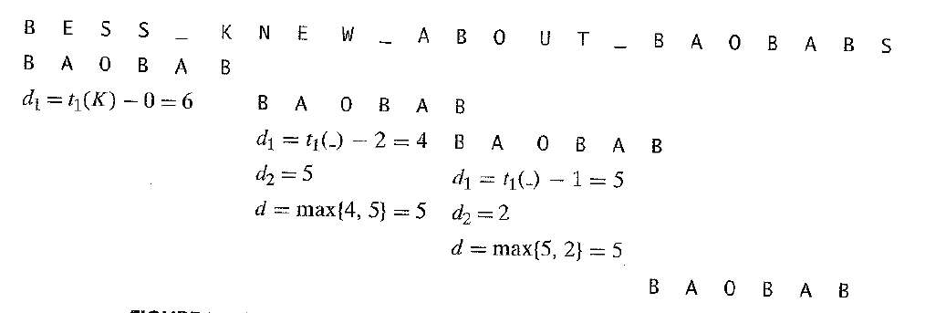
THE EXAMPLE

Slide 48
THE EFFICIENCY
The worst case efficiency of Boyer Moore algorithm is linear.

Slide 49
#######

Slide 50
HASHING

Slide 51
DICTIONARY
A dictionary is an abstract data type.
It is a set with insertion, deletion and searching operations defined on its elements.
The elements of this set are arbitrary in nature: Numbers, Characters, Strings and so on.
Practical Uses: Student Records in an educational institution, citizen records in government office, book records in a library.

Slide 52
DICTIONARY
Records generally have many fields.
Each field represents information about the entity the record represents.
Ex: In a student record, we might have ID, Name, Semester, Age and so on.
But in a record, there will be one field, the key, which uniquely identifies it.

Slide 53
HASHING
Hashing is a very efficient way of implementing dictionaries.
The idea is to distribute the keys among a one – dimensional array H[0..m-1] called the HASH TABLE.
The distribution is done by computing, for each of the keys, the value of some predefined function called the HASH FUNCTION.
This function assigns an integer between 0 and m-1 called the HASH ADDRESS.

Slide 54
HASHING
Hashing is a very efficient way of implementing dictionaries.
The idea is to distribute the keys among a one – dimensional array H[0..m-1] called the HASH TABLE.
The distribution is done by computing, for each of the keys, the value of some predefined function called the HASH FUNCTION.
This function assigns an integer between 0 and m-1 called the HASH ADDRESS.

Slide 55
HASHING - EXAMPLE
If keys are non – negative integers, then a hash function is generally of the form, h(K) = K mod m.
If keys are letters of some alphabet, we assign a position to the character in the alphabet, denoted by ord(K) and then apply the function we applied on integers.

Slide 56

HASHING - EXAMPLE
If the key is a character string c₀c₁…c_{s-1}, we use a function of the form Σ (ord(c_{i})), i goes from 0 to s-1.
Another option is:
C is a larger constant than every ord(c_{i}).

Slide 57
HASH FUNCTIONS - PROPERTIES
A hash table’s size should not be excessively large compared to the number of keys.
A hash function needs to evenly distribute the keys among the cells of the hash table.
A hash function should be easy to compute.

Slide 58
COLLISIONS
In Hashing, there will arise situations when two or more keys are hashed to the same cell. This phenomenon is called collision.
So, every hashing scheme should have a collision resolution mechanism.

Slide 59
OPEN HASHING
Also called: Separate Chaining.
In this mechanism, keys are stored in linked lists attached to cells of a hash table.
Each list contains all keys hashed to the cell.

Slide 60
OPEN HASHING - EXAMPLE
Keys:
A, FOOL, AND, HIS, MONEY, ARE, SOON, PARTED
Hash Function:
Add positions of a word’s letters in the alphabet and compute the sum’s remainder by 13.

Slide 61
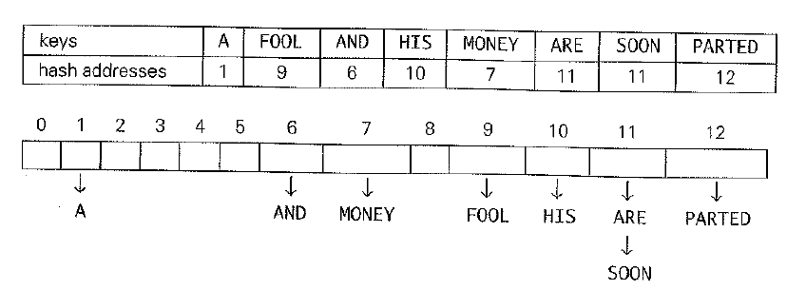
OPEN HASHING - EXAMPLE

Slide 62
OPEN HASHING - EXAMPLE
Load Factor:
If the hash function distributes n keys among m cells of the hash table evenly, each list will be n/m keys long.
Ratio α = n / m is called the Load Factor of the hash table.

Slide 63
OPEN HASHING - EXAMPLE
The average number of pointers inspected in successful searches S and unsuccessful searches U turns out to be:
S = 1 + α / 2
U = α

Slide 64
OPEN HASHING - EXAMPLE
Insertion: Done at the end of a list.
Deletion: Search for the key to be deleted and remove it.
Both operations have efficiency of Θ(1).

Slide 65
CLOSED HASHING
All keys are stored in the hash table itself without the use of linked lists.
Different strategies can be employed for collision resolution.
The simplest one is Linear Probing.

Slide 66
CLOSED HASHING
If a collision occurs, check the cell following the one where collision occurs.
If it is empty, insert the element there.
If it is already occupied, check the cell following this one and so on.
If the end of the table is reached, the search is wrapped to the beginning of the table.

Slide 67
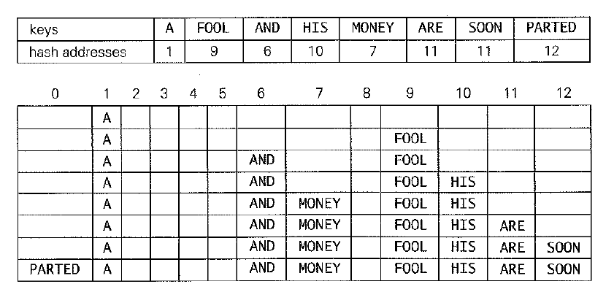
CLOSED HASHING - EXAMPLE

Slide 68
CLOSED HASHING
Search and Insertion operations are straightforward.
If we delete a key from the hash table, we will be unable to find other keys which are hashed to this cell but stored elsewhere because of Linear Probing.
Solution: Lazy Deletion – Mark previously occupied locations by a special symbol to distinguish them from locations that have not been occupied.

Slide 69

CLOSED HASHING
Number of successful searches (S) and number of unsuccessful searches (U):

Slide 70
CLOSED HASHING
Linear Probing leads to a problem called Clustering.
A cluster in linear probing is a sequence of contiguously occupied cells.
Clusters make dictionary operations less efficient.
As clusters increase, the probability that a new element will be added to the cluster increases.

Slide 71
DOUBLE HASHING
In Double Hashing, we use another hash function s(K) to determine a fixed increment for the probing sequence to be used after a collision at location l = h (k):
To guarantee that every location in the table is probed by the above sequence, the increment s(K) and table size m must be relatively prime.

Slide 72
DOUBLE HASHING
Double hashing will lead to a problem when the table gets close to being full.
Solution to this is Rehashing: All the current keys are scanned and moved to a new table.

